Slide 1

Patient Health Monitoring Portal
Cognizant
POD Members Name
Pooja Vishvakarma
Malladi Kesava Ramya
Leela Manasa Potturi

Slide 2
Contents
Abstract
Introduction
Problem Statement
Schematic Diagram
Advantages
Disadvantages
Result
Future Scope
Conclusion

Slide 3
Abstract
The aim of this project is to build a website and database for the doctor and patient. Doctors can able to view the health records of the patient and provide prescription and also they can able to view their appointments. Patient can able to suggest the doctor they need for appointment. Admin will book the appointment for patients depending on the suggestions given by the patients and also on the availability of doctors. Through this application we fix the appointments and make the patients relieve from travel stress.

Slide 4
Introduction
Patient health monitoring portal engages technology to enable healthcare providers to observe varied metrics relating to a patient’s health on an ongoing basis while the patient is outside of the conventional clinical setting, such as at their home.
In short, patient data is collected from a remote location and transmitted electronically to healthcare providers in another location for assessment.
It allows healthcare providers to track patient data as weight, activity, blood pressure, etc. which would otherwise be costly (in repeated office visits) and could lead to unwanted physical, mental, and emotional stress for the patient.

Slide 5
Problem Statement
In the absence of the doctors, the patient cannot consult the doctors due to which emergency situation may also be created. The personal health monitoring of each individual is considered very important because of the rise in health problems in today's world. The increasing stressful lifestyle is taking a maximum toll on public health. With the ever increasing queues at hospitals and an increasing number of patients, the doctor fees have sky-rocketed which is affecting especially those patients who cannot afford the fee or who are not suffering from major ailments but get to know so only after paying a hefty fee to the doctor.

Slide 6
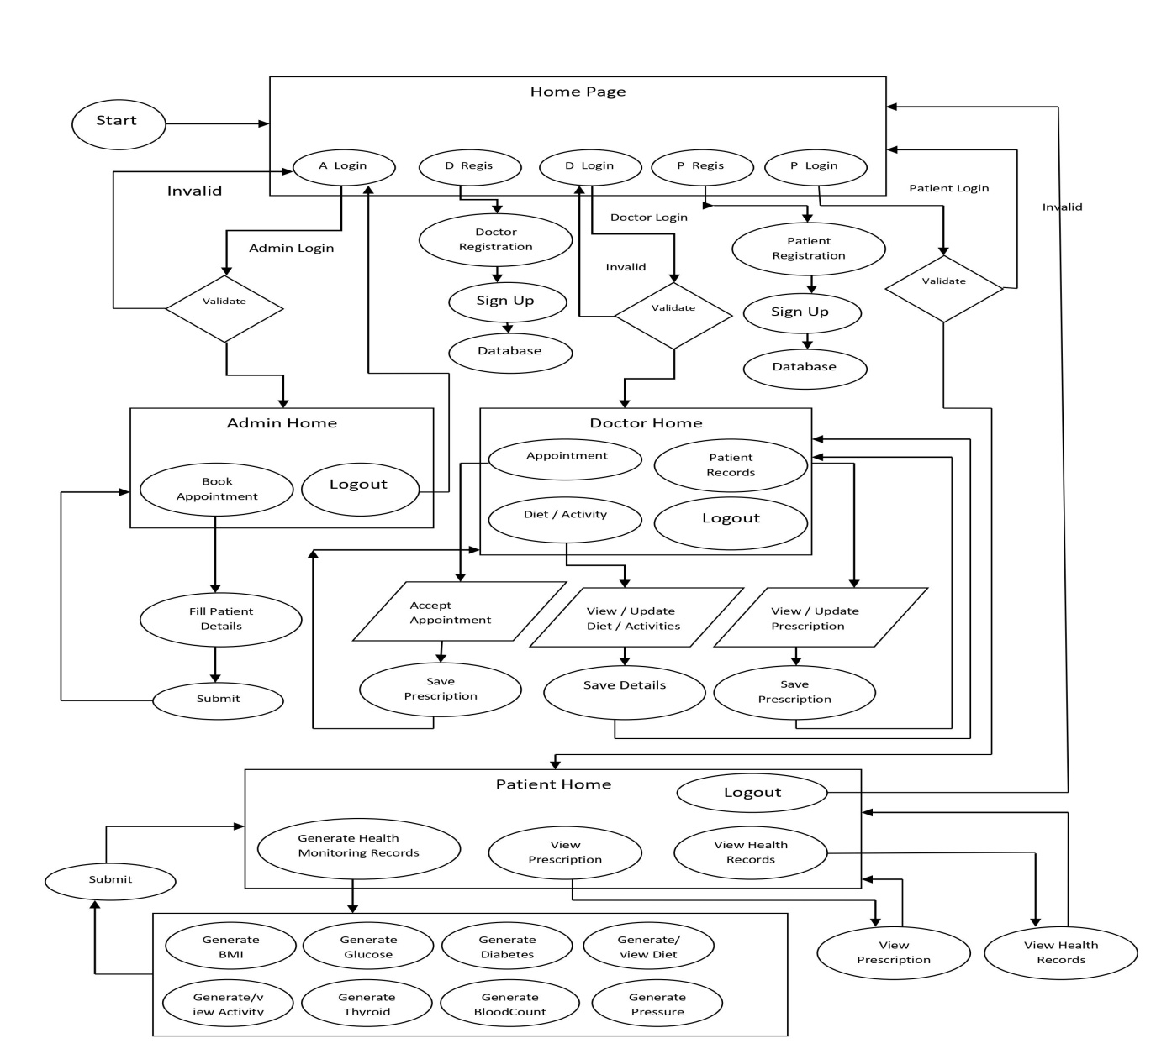
Schematic Diagram

Slide 7
Advantages
Improves data driven clinical decision making
Helps patients improve self management and care plan adherence
Cost of care reduction for payers and providers
Boosts net patient revenue
Reduces patient’s expenses and improves work productivity
Improves access to care
Builds patient engagement
Prevents the spread of infectious diseases and Hospital-Acquired Infections

Slide 8
Limitations
Privacy of Data
Limited Accessibility
Accuracy
Lack of Provider Engagement
Not Being Real-Time Monitoring

Slide 9
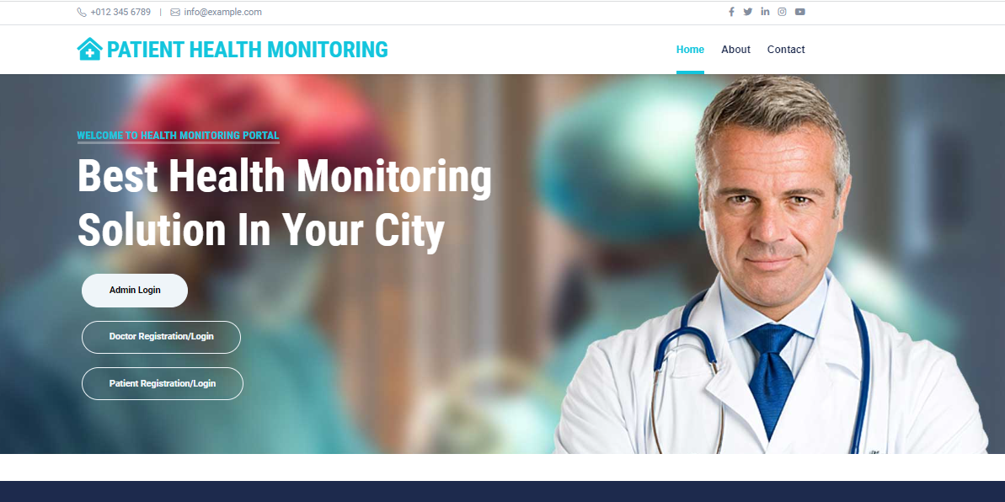
Result
Home Page

Slide 10
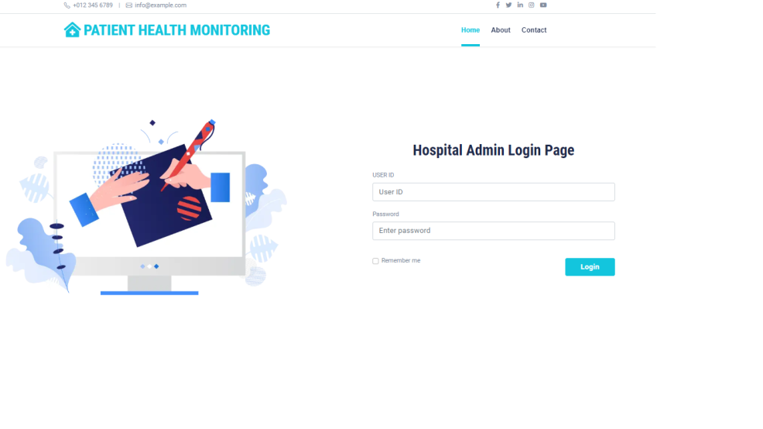
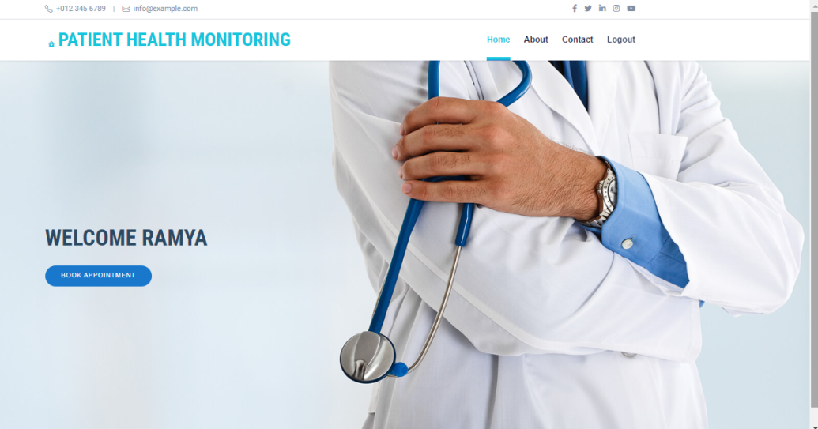
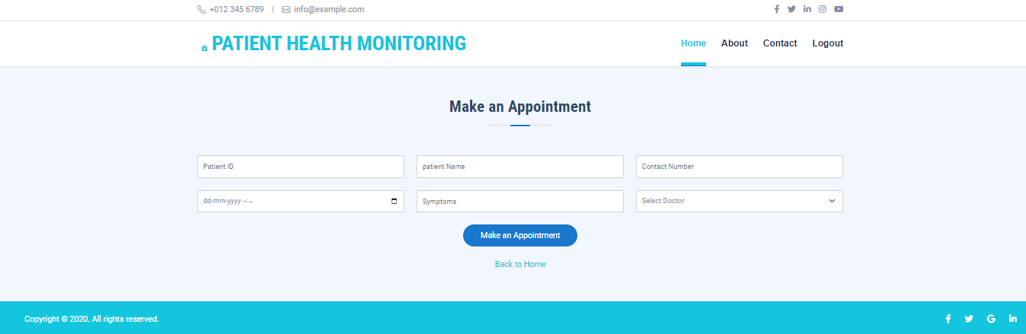
Admin Login & Home Page

Slide 11
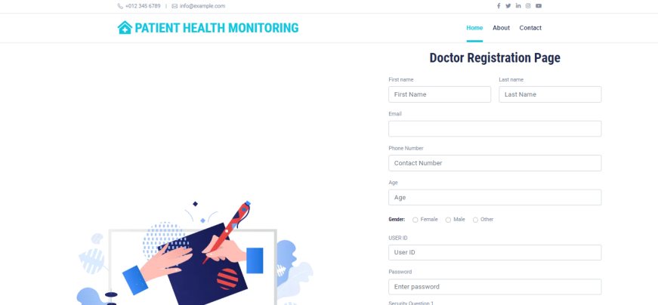
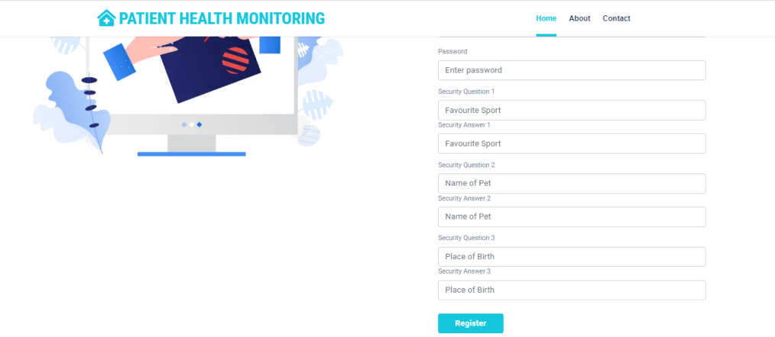
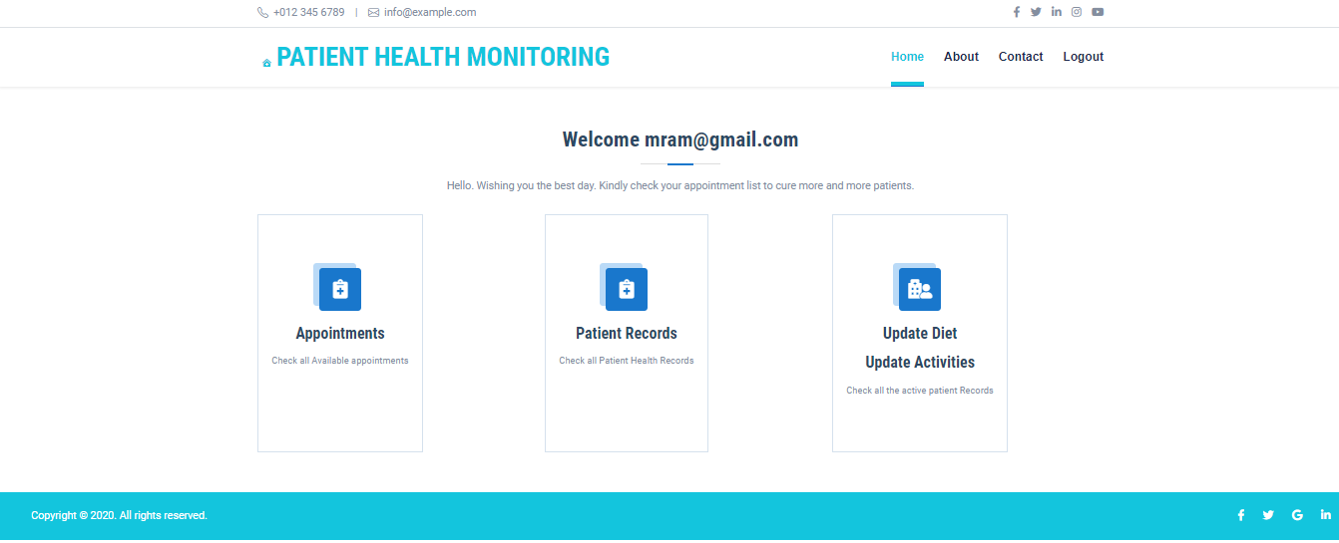
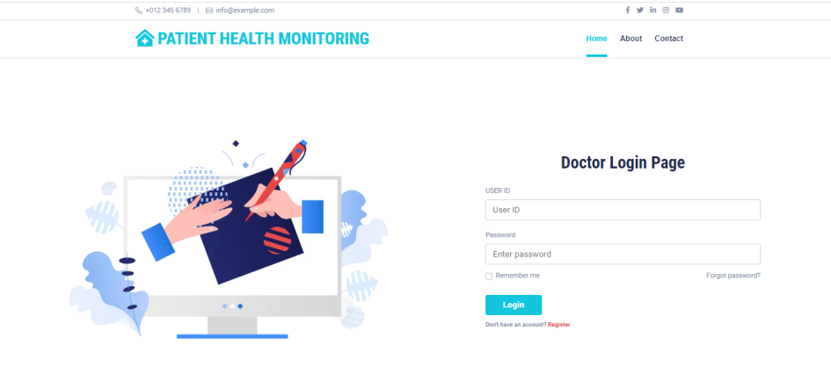
Doctor Registration, Login & Home Page

Slide 12
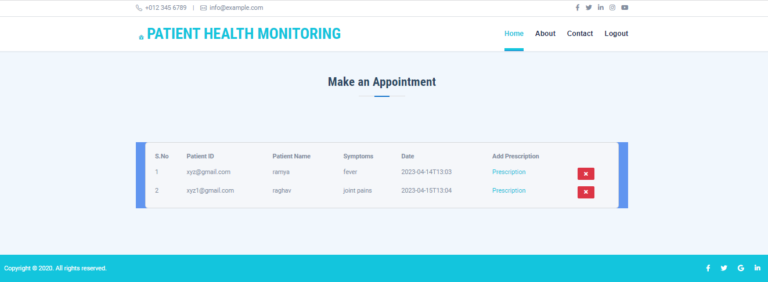
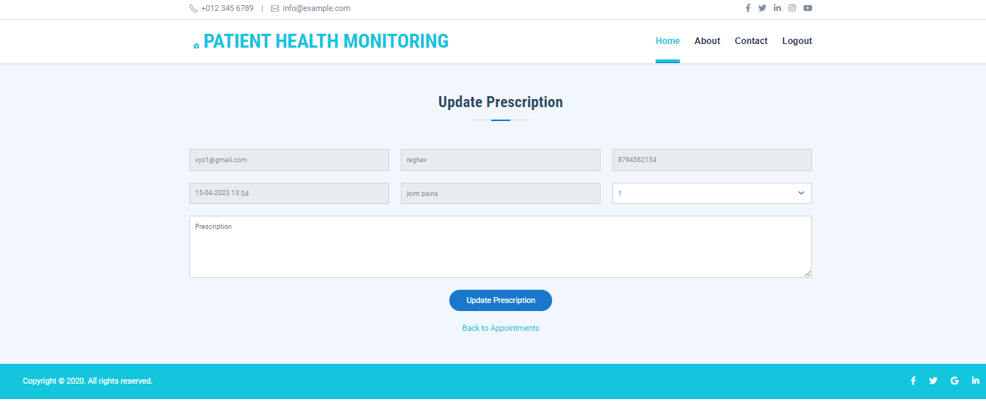
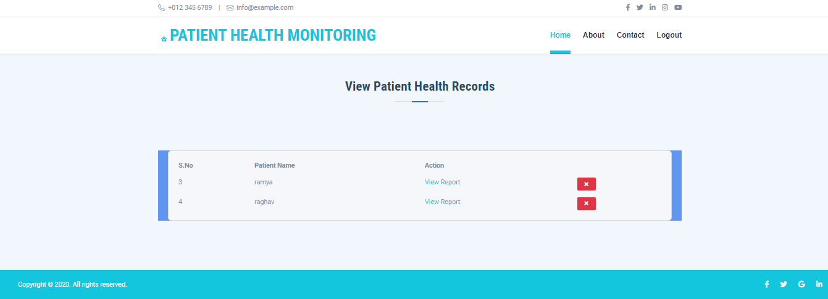
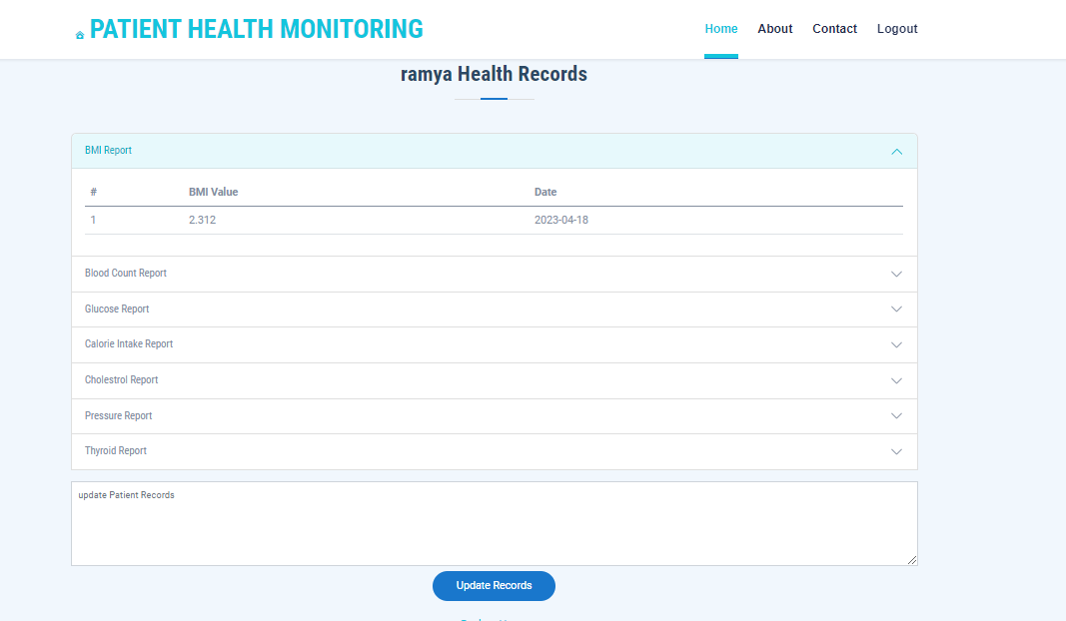
Doctor Update Prescription & check Appointments

Slide 13
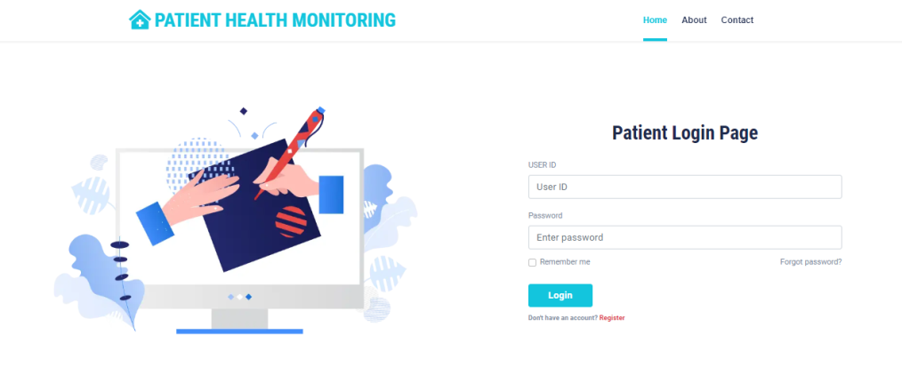
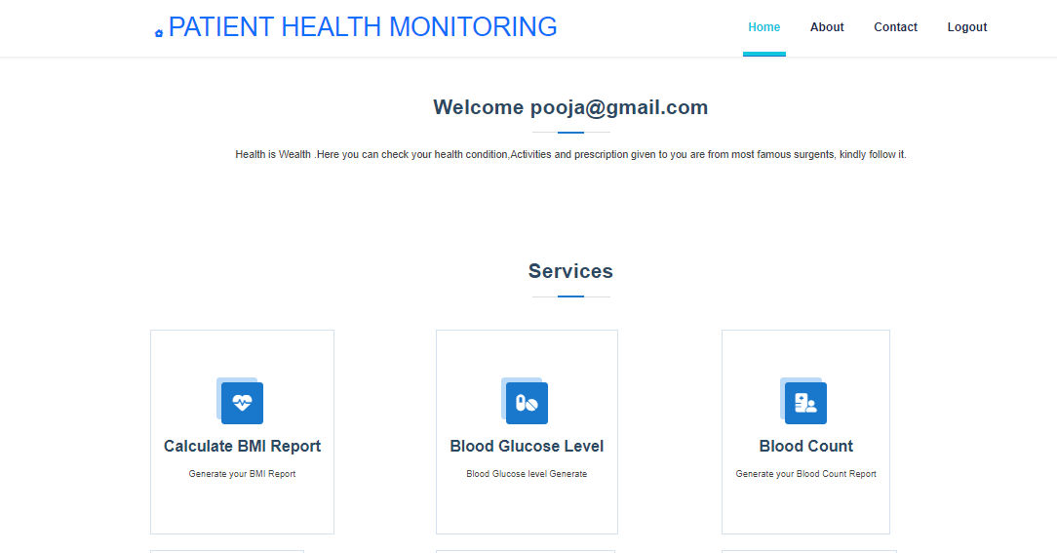
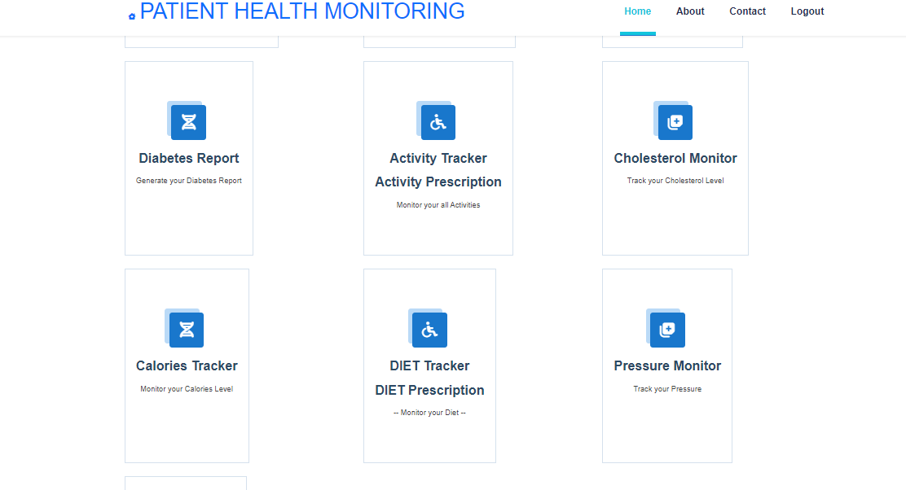
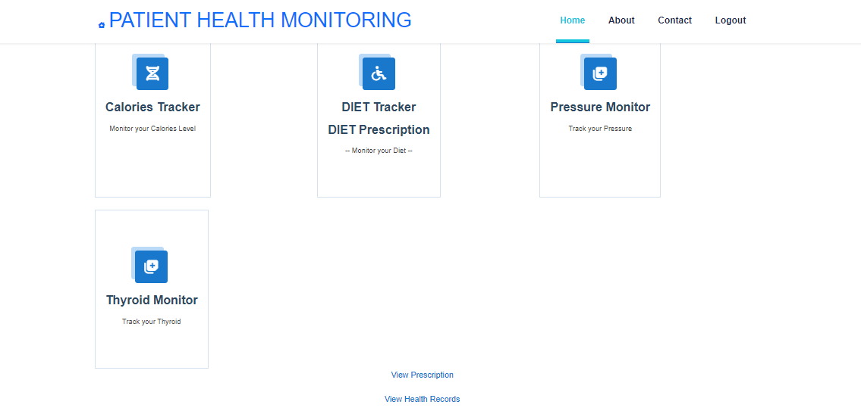
Patient Registration, Login& Home Page

Slide 14
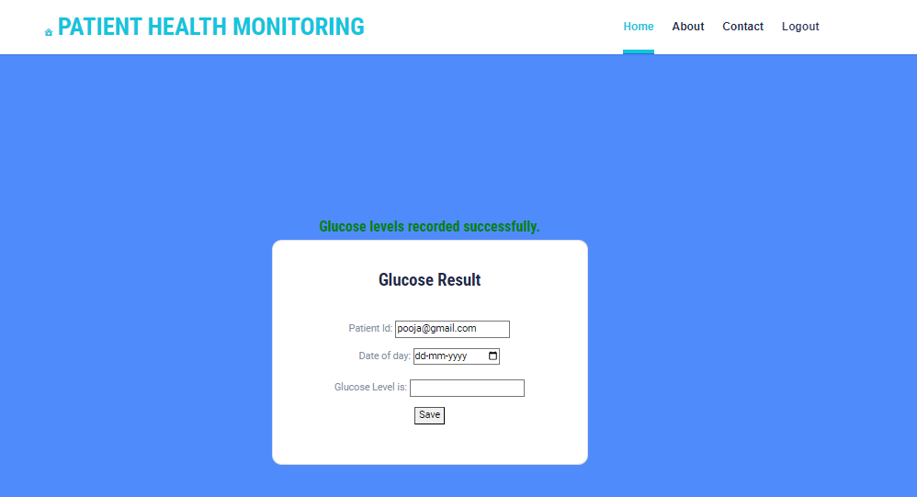
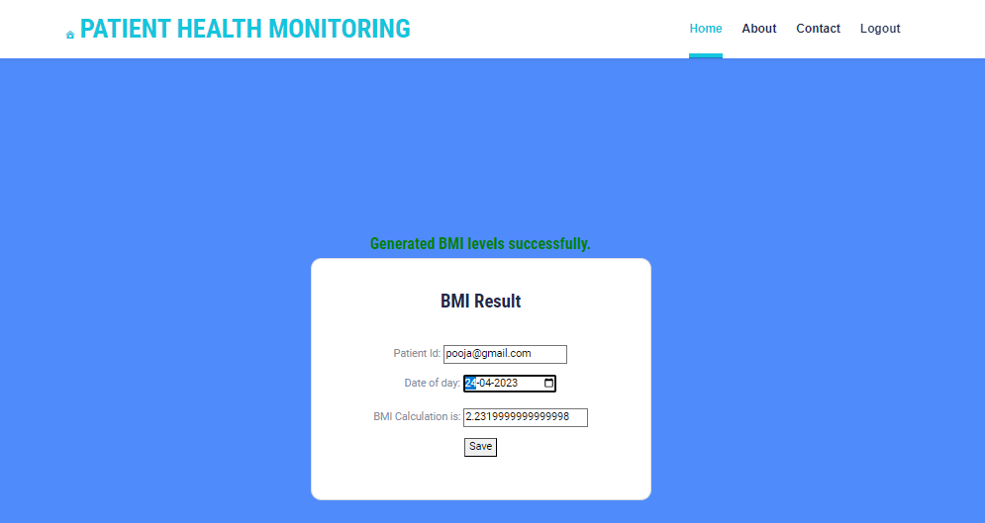
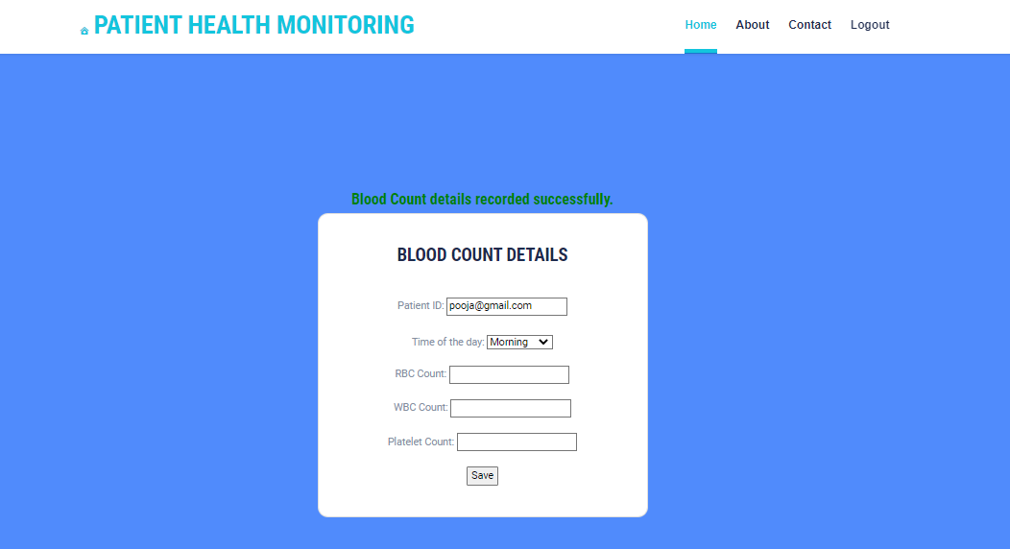
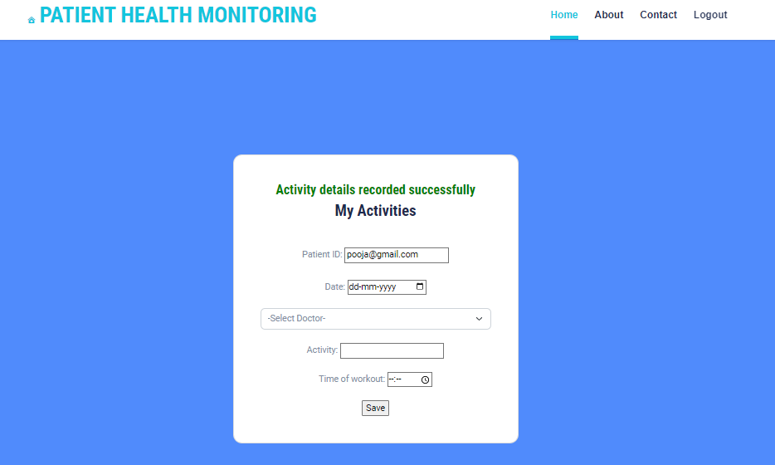
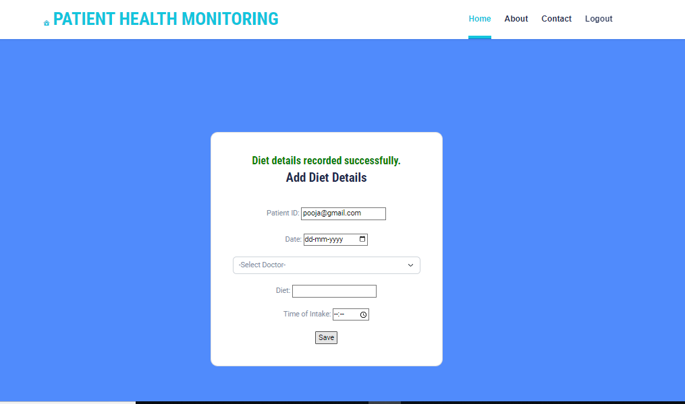
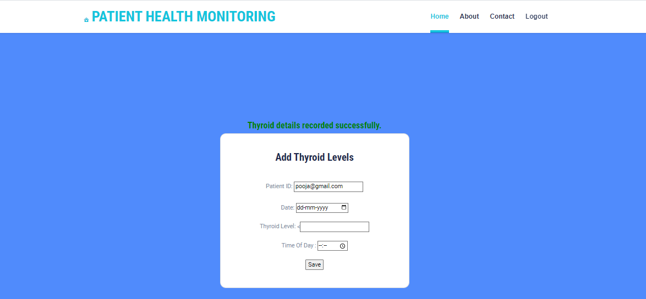
Check Patient Health Monitor

Slide 15
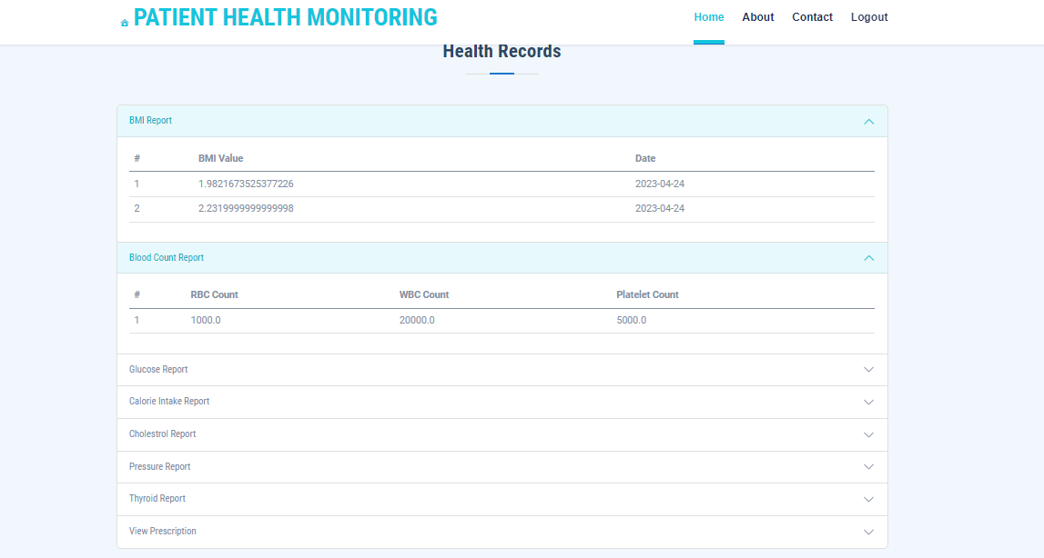
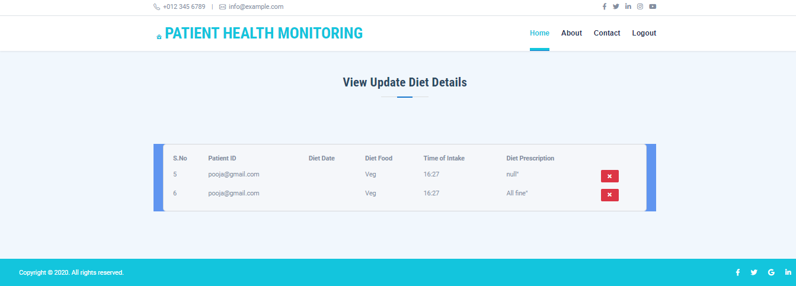
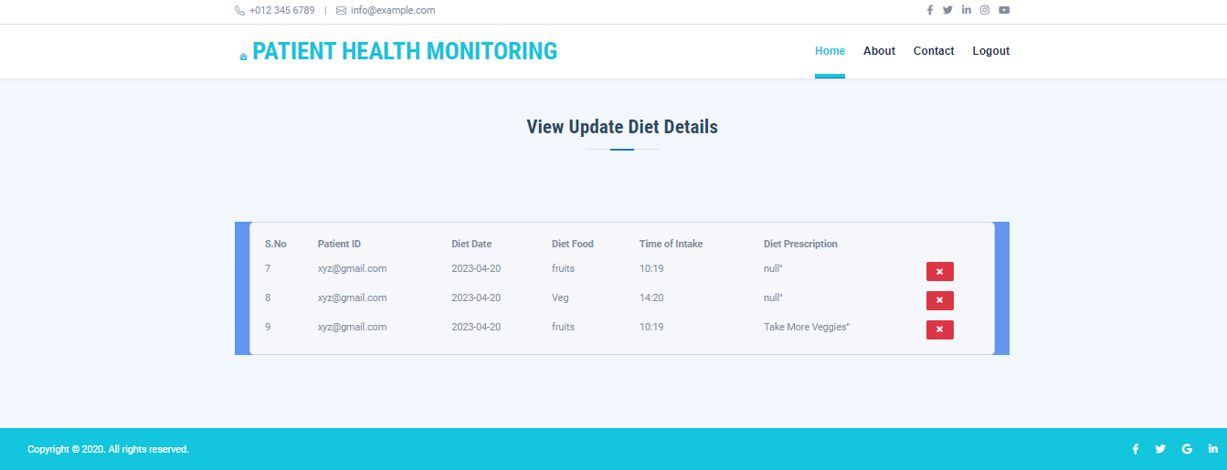
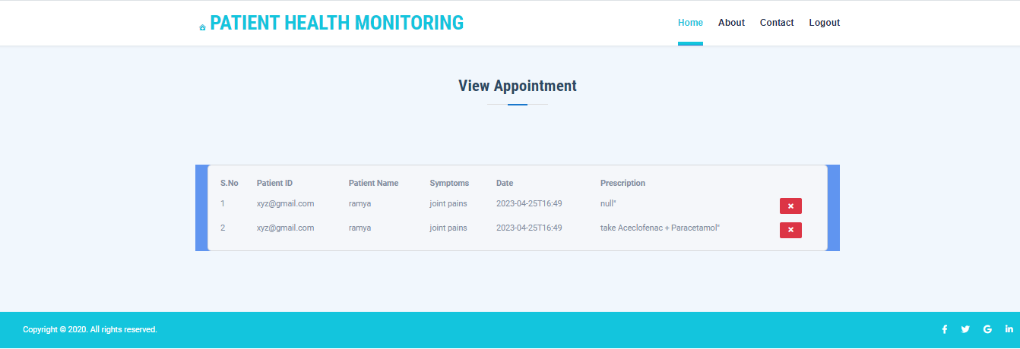
Check Prescription

Slide 16
Future Scope
The future scope of the online healthcare system seems quite bright, showing the consumers’ dependability on this technology.
With the help of IoT-enabled wearables and monitoring devices, healthcare practitioners and caregivers can easily track patients’ health from remote locations.
It can also help in keeping tabs on the real-time location of medical equipment, such as oxygen pumps, nebulizers, wheelchairs etc.

Slide 17
Conclusion
Health monitoring is growing worldwide at a faster rate in domains such as medical and healthcare, industrial processing, agriculture, public safety, environmental monitoring, smart homes and buildings, smart grid, smart mobility, etc.
It has already been widely spread in developed countries. It is due to the advancements in intelligent digital technology.
Data becomes more precise and accurate allowing the healthcare industry to have more insights into the diagnosis and treatment processes thereby improving patient outcomes.

Slide 18


